Slide 1



Slide 2



01CE0701 – Mobile Computing
Unit - 2
The Cellular Concept
Computer Engineering Department

Slide 3


Outline
Cellular System
Hexagonal Geometry cell
Concept of frequency reuse
Channel Assignment Strategies
Distance to frequency reuse ratio

Slide 4

Cellular System

Slide 5
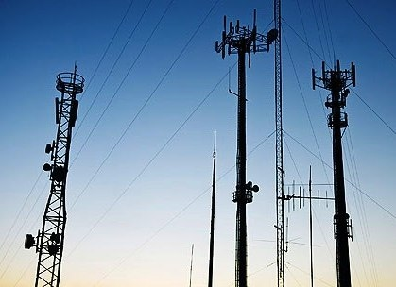
Cellular System-Introduction
A cellular network is a radio network(mobile network) spread out over land in the form of cells, each of which has a base station permanently installed. Together, these cells offer broader geographic radio coverage.
Therefore, even when the user equipment (UE), like a mobile phone, is moving through cells during transmission, communication is still possible.
In comparison to previous options, cellular networks provide subscribers with improved advantages like increased capacity, low battery consumption, a wider geographic coverage area, and less signal interference.
The Global System for Mobile Communication,
general packet radio service, 3GSM and code division multiple access are all common cellular technologies.
Cellular Network Towers

Slide 6
Cellular System in detail
A communication network that uses a wireless connection to connect end nodes is known as a cellular network or mobile network.
The network is spread out over "cells" of land, which are each served by at least one fixed-location transceiver ( A device that can both transmit and receive communications, in particular, a combined radio transmitter and receiver ).
These base stations give the cell network coverage, allowing it to transmit speech, data, and other kinds of information.
To prevent interference and assure service quality within each cell, a cell normally employs a separate set of frequencies from its neighbours.
.

Slide 7
Cellular System in detail
.
These cells can be connected to offer radio coverage across a big geographic area.
This makes it possible for a large number of portable transceivers (such as mobile phones, tablets, laptops, pagers, etc.) to communicate with each other as well as fixed transceivers and telephones throughout the network via base stations, even if some of the transceivers are moving through multiple cells at once while transmitting.

Slide 8
Cellular System -Architecture
.
The fundamental structure and infrastructure of the cellular network have not altered much.
It consists of a set of areas that are split into cells and services and are linked to one another by a network of transceivers, controllers, switches, routers, and registers. The following list includes some of the important parts and how they function:

Slide 9
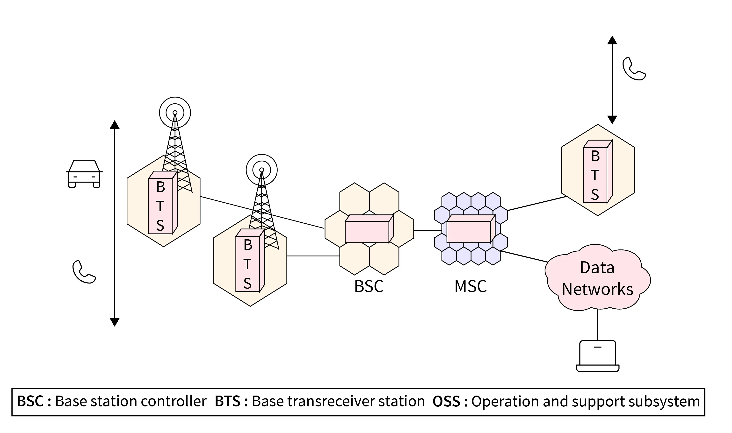
Cellular System in detail
.

Slide 10
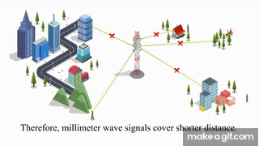
Cellular System-Features
A cellular network or mobile network is a communication network where the last link is wireless.
Cellular technology is the foundation of Mobile Wireless Communications.
It support the users in location that are not easily served by wired networks.
Cellular network is an underlying technology for mobile phones, personal communication systems, wireless networking etc.
The technology is developed for mobile radio telephone to replace high power transmitter/receiver systems with low power transmitter/receiver.
Cellular networks use low power, shorter range and more transmitters for data transmission.

Slide 11
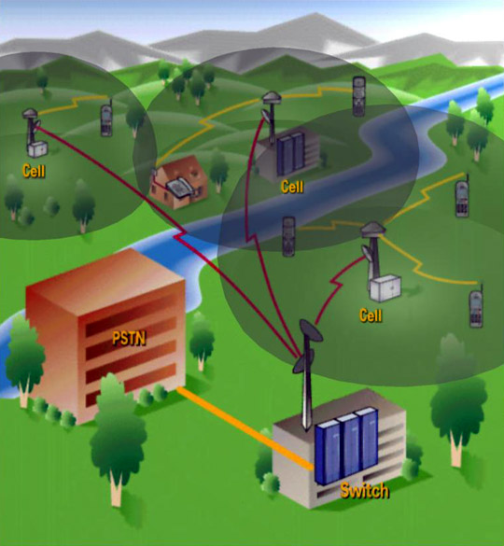
Cellular System

Slide 12
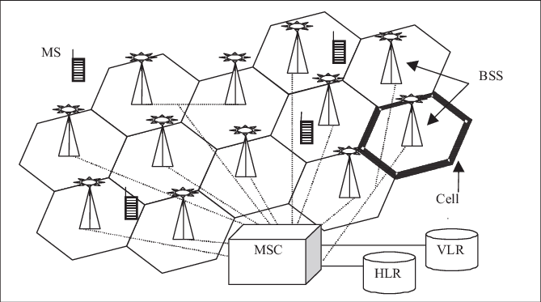
Cellular System
Multiple low power transmitters
100w or less
Area divided into cells
Each with own antenna
Each with own range of frequencies
Served by Base Station (BS)
Transmitter, receiver, control unit
Adjacent cells on different frequencies to avoid crosstalk
MS – Mobile Station
MSC – Mobile Switching Centre
HLR – Home location register
VLR – Visitor location register

Slide 13
Hexagonal Geometry Cell

Slide 14
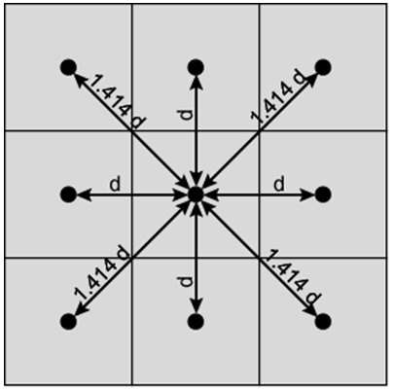
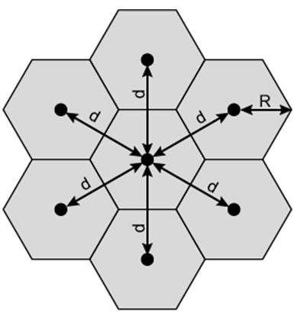
Hexagonal Geometry Cell
Square
Width d cell has four neighbours at distance d and four at distance 1.414 d
However, this geometry is not ideal
Better if all adjacent antennas equidistant
Simplifies choosing and switching to new antenna
Hexagon
Provides equidistant antennas
Radius defined as radius of circum-circle
Distance from centre to vertex equals length of side
Distance between centres of cells radius R is R
Not always precise hexagons
Topographical limitations
Local signal propagation conditions
Location of antennas

Slide 15
Concept of Frequency Reuse

Slide 16
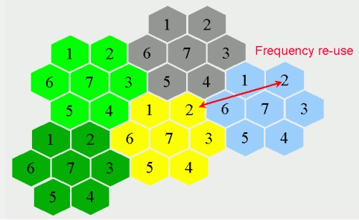
Frequency Reuse
The key characteristic of a cellular network is the ability to re-use frequencies to increase both coverage and capacity.
Many techniques are available for Multiple Access for Users by Reusing or Dividing Frequencies among users
Basic Ways of Multiple Access of Frequency:
FDMA
TDMA
CDMA

Slide 17

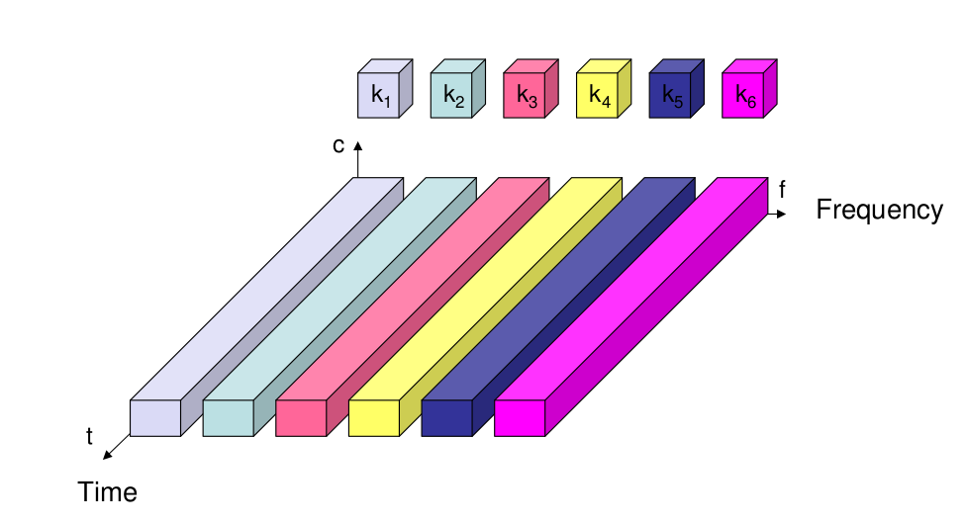
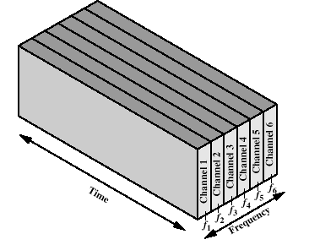
Frequency Division Multiple Access (FDMA)
Analog technique
FDM is a technique in which the available bandwidth of a single transmission medium is subdivided into several channels.
In FDM, all signals operate at the same time with different frequency.
FDM is mainly used in radio broadcasts and TV networks.
Radio stations: Each radio station has its own frequency.
Receiver: Tune in to the specific frequency.

Slide 18
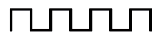
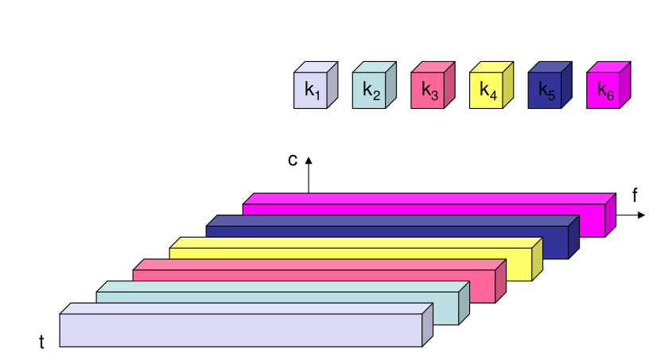
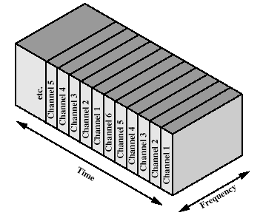
Time Division Multiple Access (TDMA)
Digital technique
In TDM, the total time available in the channel is distributed among different users. Therefore, each user is allocated with different time interval known as a Time slot at which data is to be transmitted by the sender.
In TDM, all signals operate at the same frequency with different time.
A user takes control of the channel for a fixed amount of time.
In TDM, data is not transmitted simultaneously rather the data is transmitted one-by-one.
TDM is mainly used in Telephone lines, ISDN (Integrated Services Digital Network) telephone lines.

Slide 19
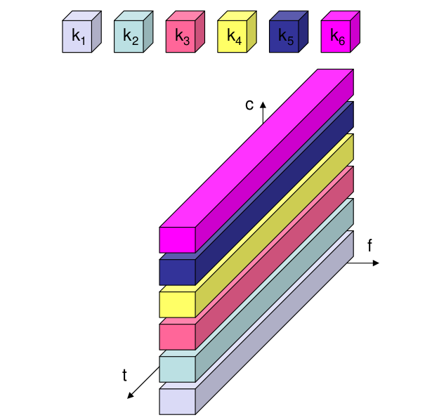
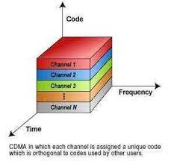
Code Division Multiple Access (CDMA)
Each channel has a unique code
All channels use the same spectrum at the same time
First used in military applications due to its inherent security features.
Now used in many civil applications due to low processing power.
Ex., people talk different languages in a party.
If the listener doesn’t know the language, the signals are received but useless.
CDMA allows for greater development and use of broadband devices such as GPS units, PDA's, wireless laptop modems, Internet capable cell phones, and other innovative devices.

Slide 20
Channel Assignment
Strategies

Slide 21
Channel Assignment/Allocation Strategies
What is Channel Allocation?
Channel Allocation means to allocate the available channels to the cells in a cellular system.
When a user wants to make a call request then by using channel allocation strategies their requests are fulfilled.
Purpose
Channel Allocation Strategies are designed in such a way that there is efficient use of frequencies, time slots and bandwidth.
Channel Allocation Strategies
Fixed Channel Allocation (FCA)
Dynamic Channel Allocation (DCA)

Slide 22
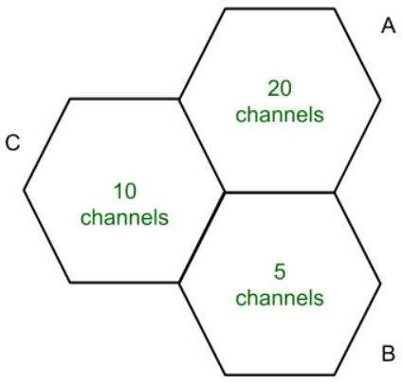
Fixed Channel Allocation
Fixed Channel Allocation
Fixed Channel Allocation is a strategy in which fixed number of channels or voice channels are allocated to the cells.
Once the channels are allocated to the specific cells then they cannot be changed.
In FCA channels are allocated in a manner that maximize Frequency reuse.
In cell A 20 Channels or Voice channels are allocated. If all channels are occupied and user make a call then the call is blocked.
Borrowing Channels handles this type of problem. This cell borrow channels from other cells.

Slide 23
Dynamic Channel Allocation
Dynamic Channel Allocation
Dynamic Channel allocation is a strategy in which channels are not permanently allocated to the cells.
Channels are assigned to the user as needed.
In this strategy, blocking calls is reduced. As traffic increases more channels are assigned and vice-versa.
The available channels are kept in a queue or a spool. The allocation of the channels is temporary.
When a User makes a call request then Base Station (BS) send that request to the Mobile Station Center (MSC) for the allocation of channels or voice channels.
Dynamic channel allocation schemes increases the computational as well as storage load on the system.

Slide 24
Distance to Frequency Reuse Ratio

Slide 25
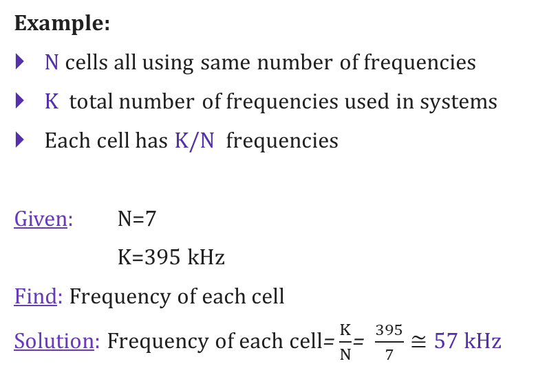
Frequency Reuse
Example:
N cells all using same number of frequencies
K total number of frequencies used in systems
Each cell has K/N frequencies
Given: N=7
K=395 kHz
Find: Frequency of each cell
Solution: Frequency of each cell=$\frac{K}{N}$= $\frac{395}{7}≅57 kHz$
2
7
3
1
6
4
5

Slide 26
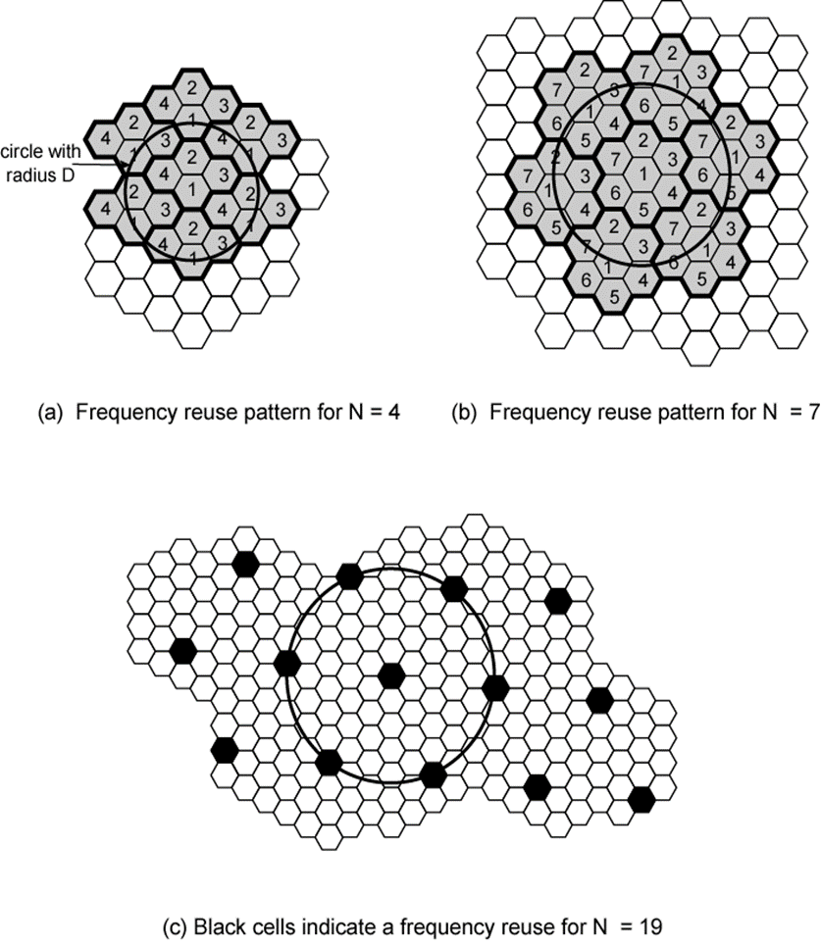
Cluster Size
How to find cluster size of cellular network?

Slide 27
Cluster Size
How to find cluster size of cellular network?
Formula:
1
N=I²+J²+(I * J)
5
N: | No. of cell with unique/non repeated frequency
2
2
7
3
1
6
4
5

Slide 28
Cluster Size
How to find cluster size of cellular network?
Formula:
Now, if we want to find distance to reach from cell1 to another cell1 then,
Given: I=1, J=2
Solution: N=1²+2²+(1*2)
=1+4+2
=7
1
N=I²+J²+(I * J)
j=2
N: | No. of cell with unique/non repeated frequency
5
j=1
2
2
I: | No. of steps required to move in one direction in order to reach cell with same frequency
j=1
i=2
J: | No. of steps required to move in other direction(i.e. 60° anticlockwise) in order to reach cell with same frequency.
7
i=1
3
1
6
i=1
4
5

Slide 29
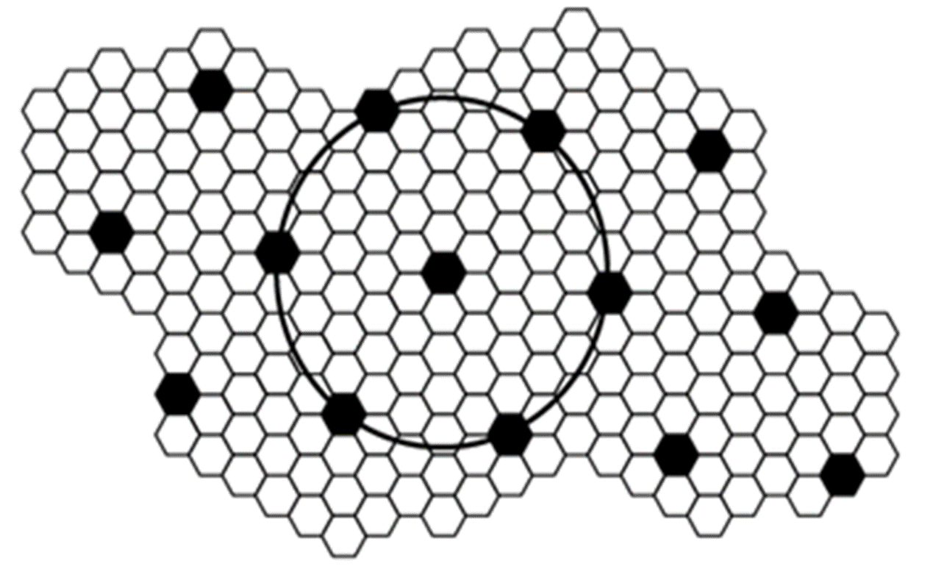
Cluster Size
How to find cluster size of cellular network?
Formula:
Now, if we want to find distance to reach from cell1 to another cell1 then,
Given: I=2, J=3
Solution: N=2²+3²+(2*3)
=4 + 9 + 6
=19
N=I²+J²+(I * J)

Slide 31
Concept of Spread Spectrum

Slide 32
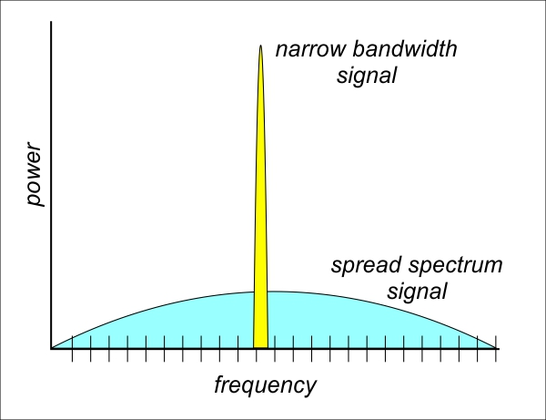
Concept of Spread Spectrum
A collective class of signalling techniques are employed before transmitting a signal to provide a secure communication, known as the Spread Spectrum Modulation.
The pivotal aim of spread spectrum communication technique is to prevent “interference” whether it is intentional or unintentional.’
The spread spectrum signals are hard to interfere and can’t be jammed.

Slide 33
Concept of Spread Spectrum
Narrow Band Signal features
Band of signals occupy a narrow range of frequencies
Power density is high
Spread of energy is low and concentrated
Signals are prone to interference
Spread Spectrum Signal features
Band of signals occupy a wide range of frequencies
Power density is very low
Energy is wide spread
Highly resistant to interference or jamming

Slide 34
Concept of Spread Spectrum
Input
Data
Output
Data
Channel Encoder
Modulator
Channel
Demodulator
Channel Decoder
Spreading
Code
Spreading
Code
Pseudo-noise generator
Pseudo-noise generator
Applications
Military communication
It can also be used for hiding and encrypting signals. Only a recipient who knows the spreading code can recover the encoded information.

Slide 35
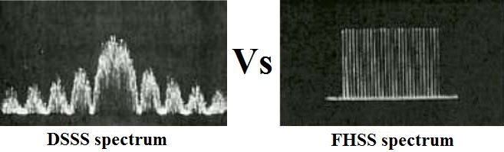
Concept of Spread Spectrum
Spread Spectrum
Frequency Hoping Spread Spectrum
(FHSS)
Direct Sequence
Spread Spectrum
(DSSS)

Slide 36
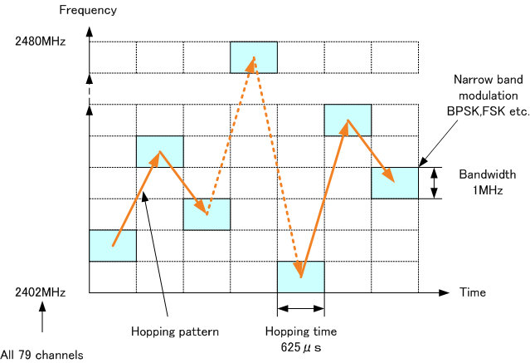
Frequency Hopping Spread Spectrum (FHSS)
The first type of spread spectrum developed is known as frequency hopping.
The sequence of channels used is indicated by a spreading code.
Signal is broadcast over seemingly random series of radio frequencies
A number of channels allocated for the FH signal
Width of each channel corresponds to bandwidth of input signal
Signal hops from frequency to frequency at fixed intervals
Transmitter operates in one channel at a time
Bits are transmitted using some encoding scheme
At each successive interval, a new carrier frequency is selected

Slide 37
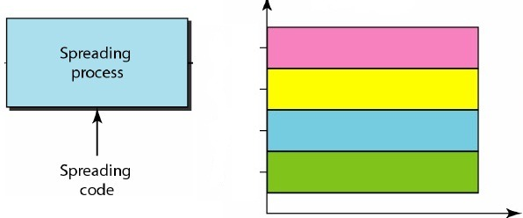
Direct Sequence Spread Spectrum (DSSS)
Each bit in original signal is represented by multiple bits in the transmitted signal
Spreading code spreads signal across a wider frequency band
One technique combines digital information stream with the spreading code bit stream using exclusive-OR.

Slide 38
Direct Sequence Spread Spectrum (DSSS)
0 | 1 | 1 | 0 | 0
0 | 1 | 0 | 1 | 0
0
1
Data Input Signal (A)
PN bit stream (B)
0
0
1
1
0
1
C=A ⊕ B

